Slide 1
EXPLORING UPI TRANSACTION PATTERN AND FRAUD DETECTION
Guided by
Dr.T.PREMALATHA,MCA.,M.Phil.,PhD.,
DEPARTMENT OF DATA SCIENCE
PRESENTED BY
JAMUNA G (2428M0128)

Slide 2
Contents of this template
SYNOPSIS | Brief summary explaining the project’s aim and purpose.
OVERVIEW OF DATASET | Overview of data source and key features.
DATA PREPROCESSING | Process of cleaning and transforming raw data.
FRAUD FLAG CREATION | Identifying and labeling suspicious transactions.
DATA ANALYSIS & DATA VISUALIZATION | Interpreting data through graphs and insights.
PREDICTIVE MODEL | Building a model to predict fraudulent activity.
CONCLUSION
Final summary of outcomes.

Slide 3
SYNOPSIS
The Unified Payments Interface (UPI) enables quick and secure digital payments in India. As transactions grow, fraud risks also increase. This project uses data science and machine learning to detect and prevent UPI fraud. The data is cleaned, analyzed, and used to train a Random Forest model that predicts suspicious transactions, helping make digital payments safer and more trustworthy.

Slide 4
OVERVIEW OF DATASET
Transaction_ID: Unique ID assigned to each UPI transaction.
Sender_Name: Name or ID of the user who sent the money.
Receiver_Name: Name or ID of the user who received the money.
Sender_Bank: Bank associated with the sender’s UPI account.
Receiver_Bank: Bank associated with the receiver’s UPI account.
Amount_INR: Transaction amount in Indian Rupees.
Transaction_Type: Type of transaction – P2P (Person-to-Person) or P2M (Person-to-Merchant).
Transaction_Status: Result of the transaction – Success, Failed, Pending, or Suspicious.
Device_Type: Device used for the transaction such as Android, iOS, or Desktop.
Merchant_Category: Type of business or service (Retail, Food, Travel, etc.).
Geo_Region: Geographical region where the transaction occurred.

Slide 5
OVERVIEW OF DATASET
State: Indian state derived from the transaction’s location data.
Latitude: Latitude coordinate of the transaction location.
Longitude: Longitude coordinate of the transaction location.
Sender_Age_Group: Age range of the sender (e.g., 18–25, 26–35).
Account_Tenure: Duration for which the sender’s account has been active.
Time_Stamp: Exact date and time of the transaction.
Hour: Hour of the transaction extracted from the timestamp.
Day: Day of the week on which the transaction occurred.
Month: Month in which the transaction took place.
Device_Type_Encoded: Numerical code assigned to each device type.
Status_Encoded: Numerical code assigned to each transaction status.
Fraud_Flag: Indicates whether the transaction is genuine (0) or fraudulent (1).

Slide 6
DATA PREPROCESSING
Data Cleaning: Removed duplicates and handled missing data.
Data Conversion: Converted date and amount into correct formats.
Data Grouping: Combined transactions to study user behavior.
Feature Creation: Added hour, day, and month for time analysis.
Text Cleaning: Cleaned merchant and transaction text columns.
Data Splitting: Split data for training and testing.
Scaling: Kept all numeric values in similar range.

Slide 7
FRAUD FLAG CREATION
A fraud flag is created to identify suspicious transactions in the dataset. Transactions are marked as fraudulent (1) if they show unusual behavior such as:
Very high transaction amounts,
Failed or suspicious status, or
Transactions made at odd hours.
All other transactions are marked as non-fraudulent (0). This flag helps the model learn and detect future fraud patterns effectively.

Slide 8
DATA ANALYSIS & DATA VISUALIZATION

Slide 9
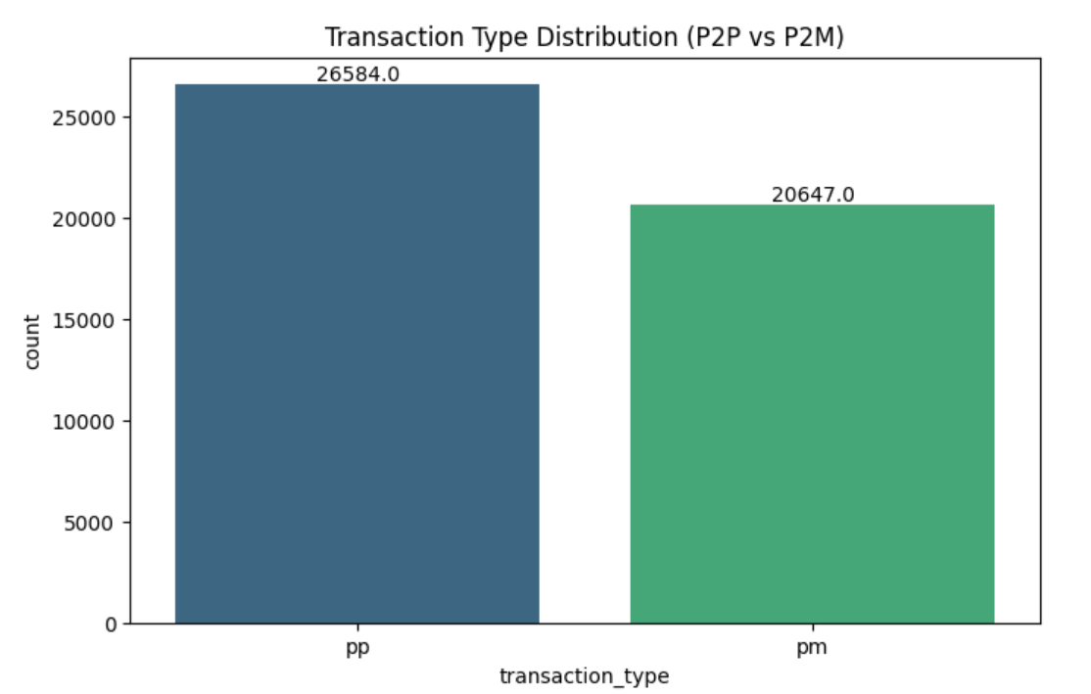
TRANSACTION TYPE DISTRIBUTION (P2P VS P2M)
This analysis compares P2P (Person-to-Person) and P2M (Person-to-Merchant) transactions. It helps identify which type is more commonly used and which shows a higher risk of fraud.

Slide 10
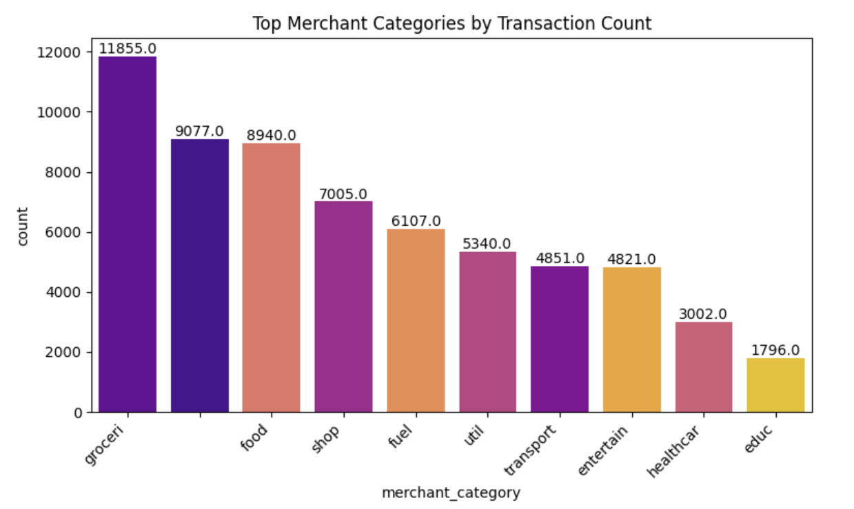
Top Merchant Categories by Transaction Count and Fraud Status
This shows which merchant categories receive the most transactions and fraud cases. It helps detect high-risk sectors like retail, travel, and utilities where fraud occurs frequently.

Slide 11
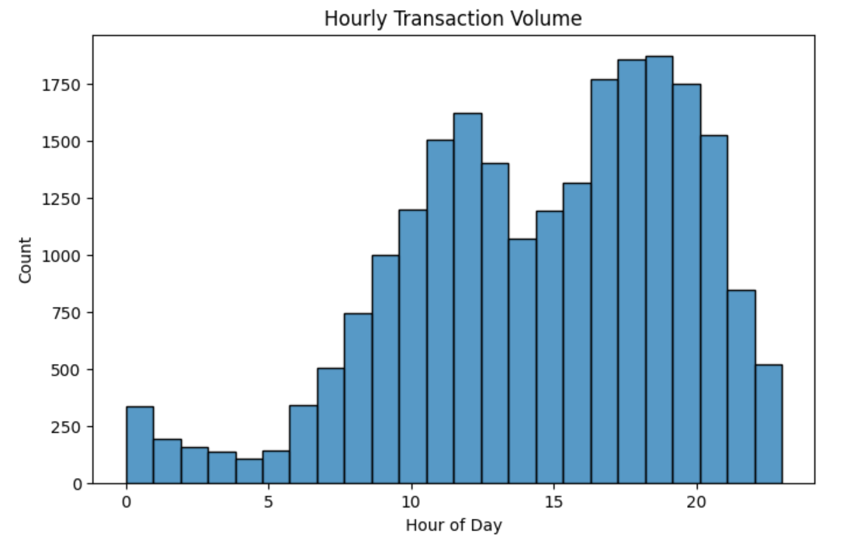
Hourly Transaction Volume
This shows how transaction activity changes across different hours of the day. It helps detect unusual transaction spikes during odd or late-night hours that may indicate fraud.

Slide 12
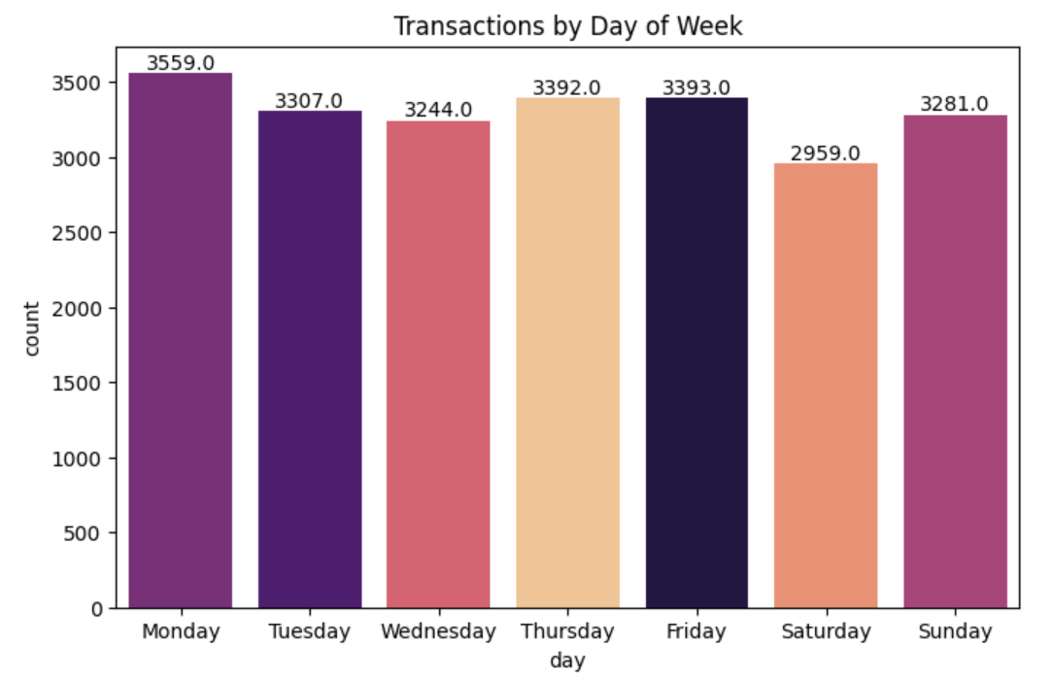
Transactions by Day of Week
This shows the number of transactions on each weekday. It helps identify peak transaction days and understand when fraud is more likely.

Slide 13
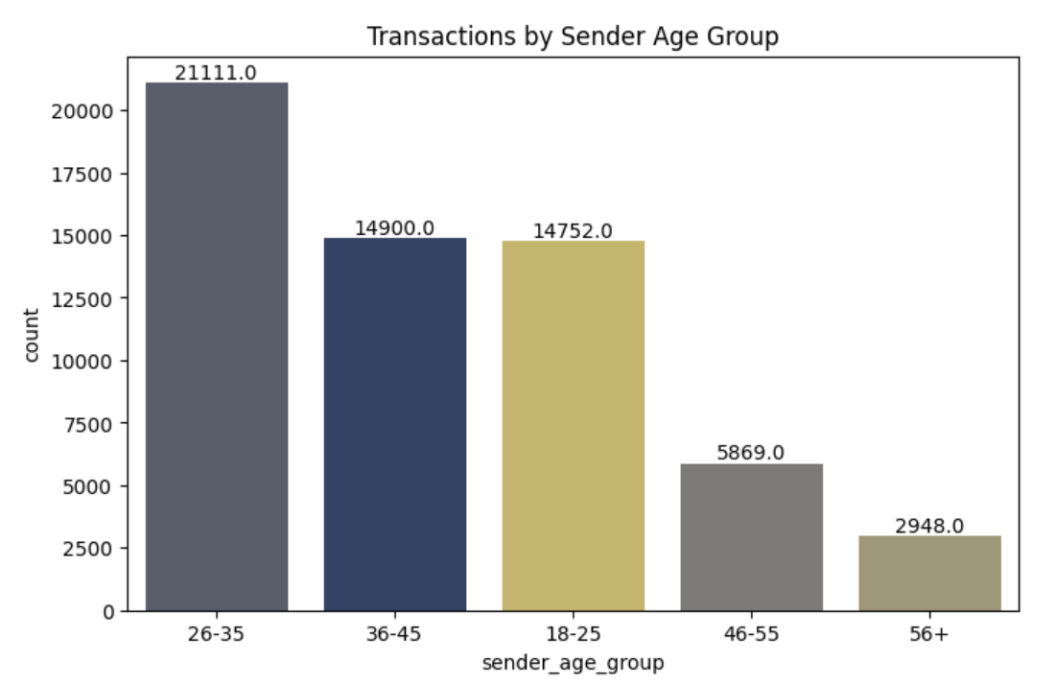
Transactions by Sender Age Group
This shows which age groups are most active in UPI payments. It helps focus fraud awareness and prevention on highly active users.

Slide 14
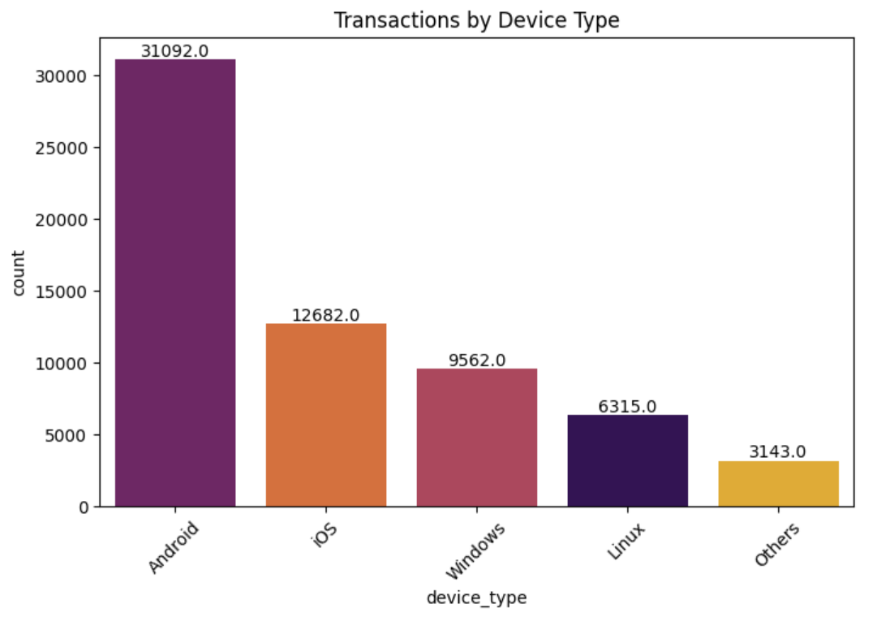
Transactions by Device Type
This shows which devices are most used for UPI transactions. It helps identify devices that face more failed or fraudulent payments.

Slide 15
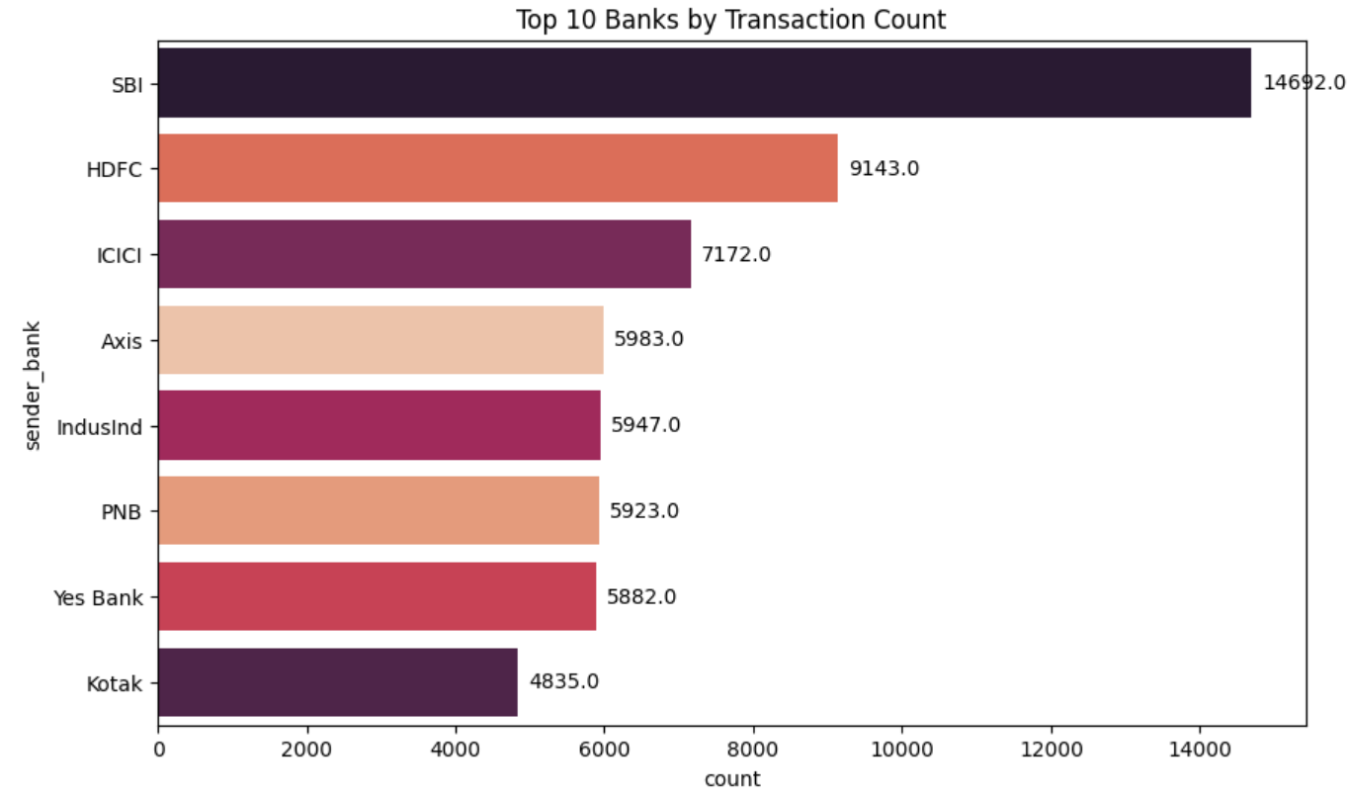
Top 10 Banks by Transaction Count
This highlights the banks handling the most UPI transactions. It helps find banks that may need stronger fraud detection systems.

Slide 16
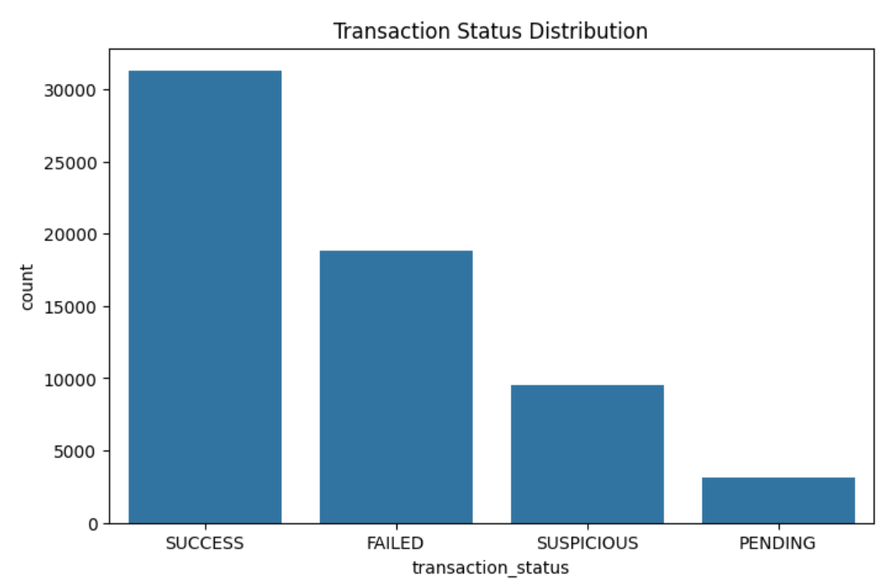
Transaction Status Distribution
This divides transactions into Success, Failed, Pending, or Suspicious. It helps identify failure patterns that are commonly linked to fraud.

Slide 17
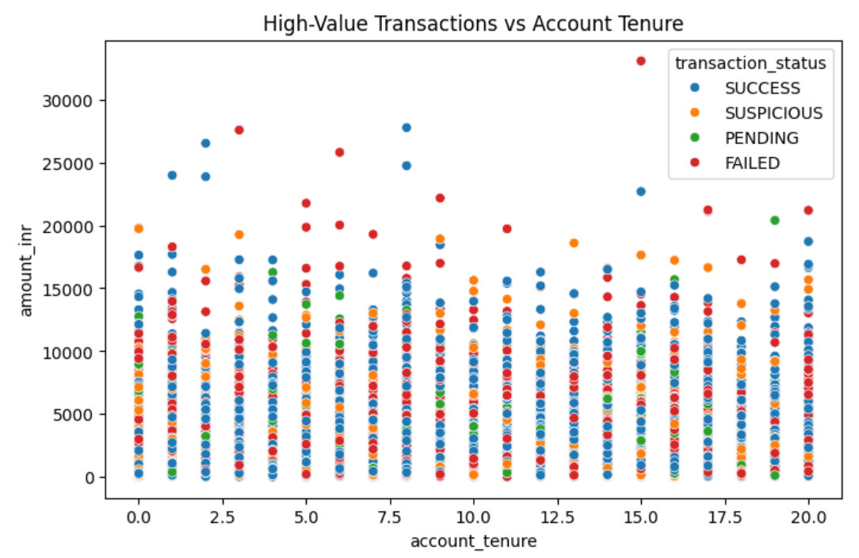
High-Value Transactions vs Account Tenure
This compares large payments with account age. It helps detect new accounts performing high-value transactions, which may be suspicious.

Slide 18
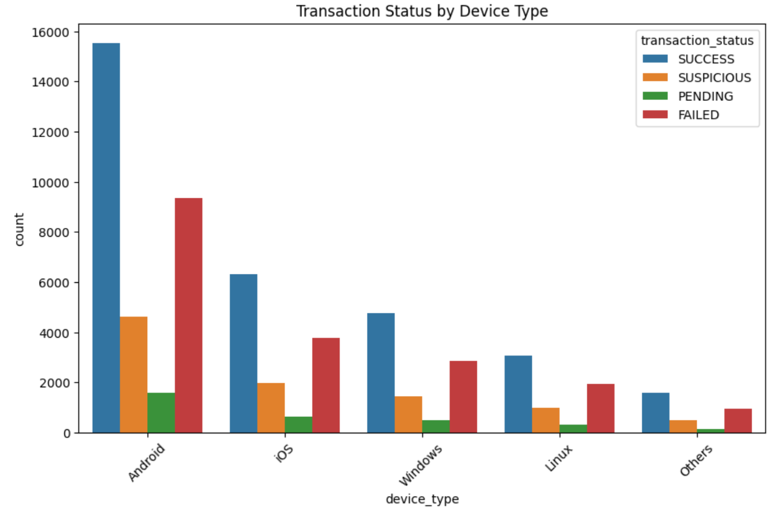
Transaction Status by Device Type
This compares transaction results across different device types. It helps detect devices showing frequent fraud or failed attempts.

Slide 19
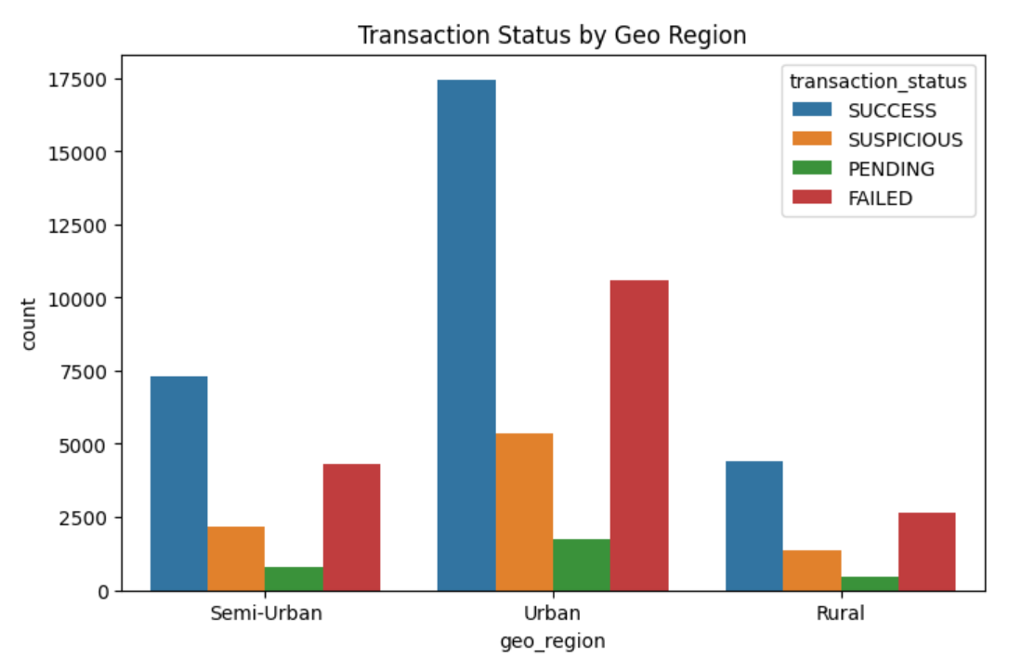
Transaction Status by Geo Region
This shows how transaction results differ by region. It helps locate areas with more failed
or fraudulent transactions.

Slide 20
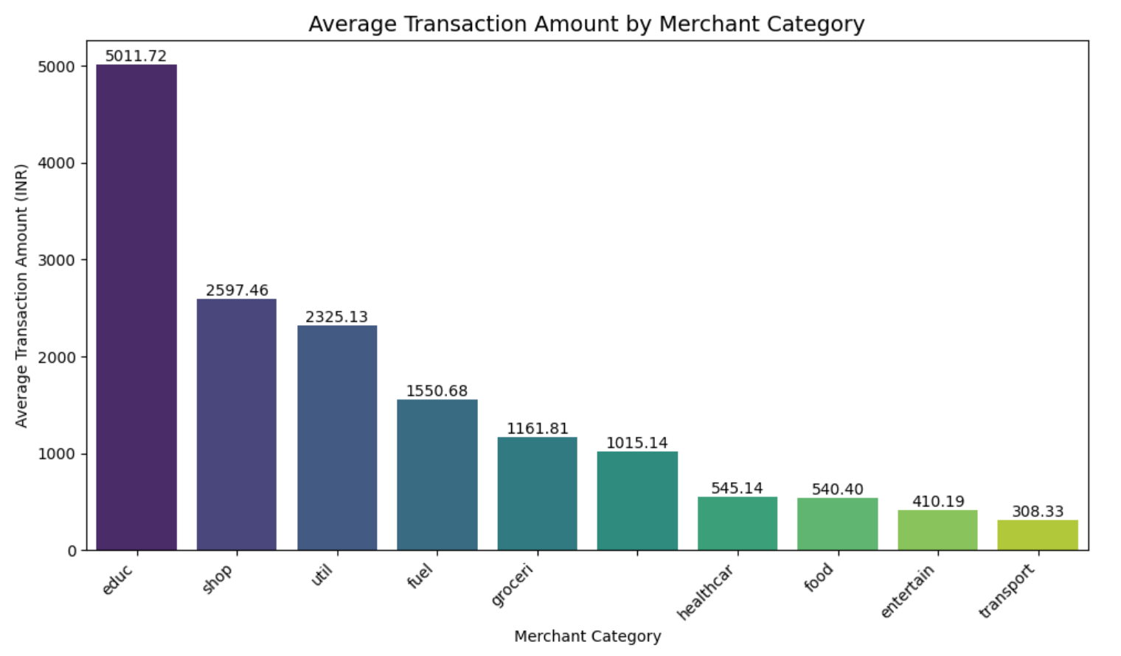
Average Transaction Amount by Merchant Category
This shows the average transaction size for each merchant category. It helps identify merchant types that often involve high-value frauds.

Slide 21
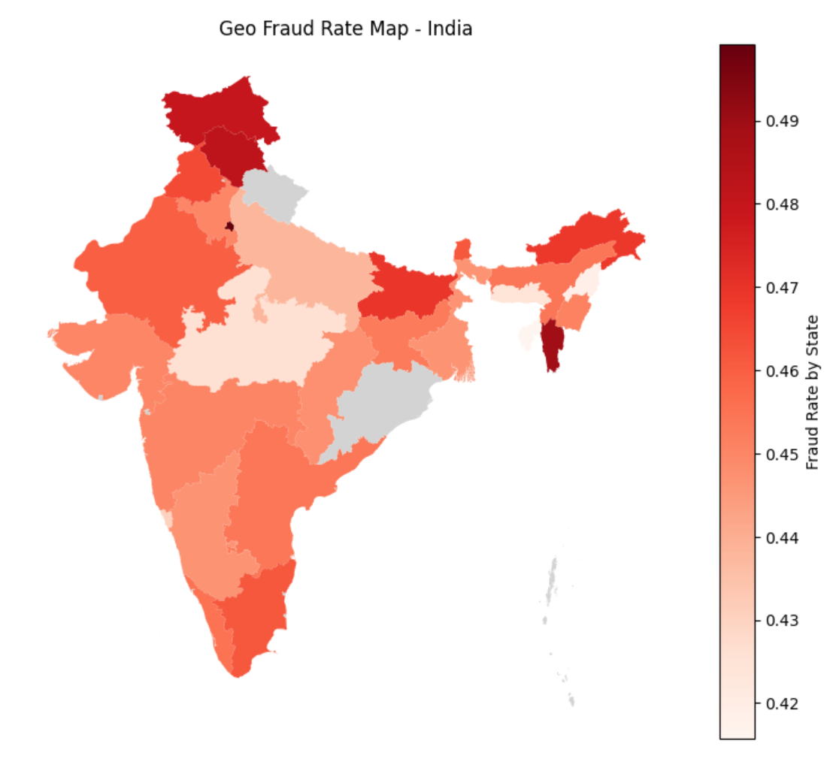
Geo Fraud Map (India)
This shows state-wise fraud rates across India using a map. It helps identify regions with higher fraud risk for focused prevention.

Slide 22
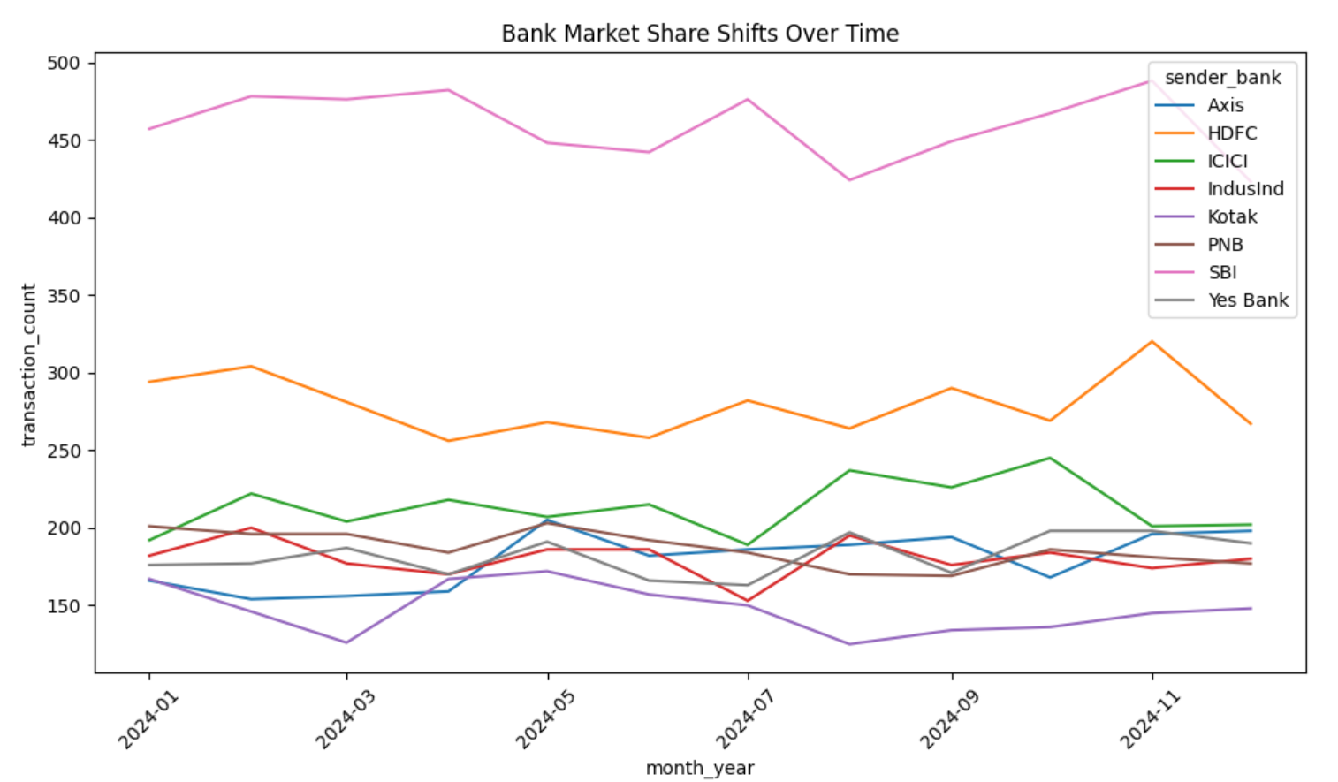
Bank Market Share Shifts Over Time
This tracks how UPI transactions of banks change over months. It helps detect growth trends and sudden increases linked to fraud.

Slide 23
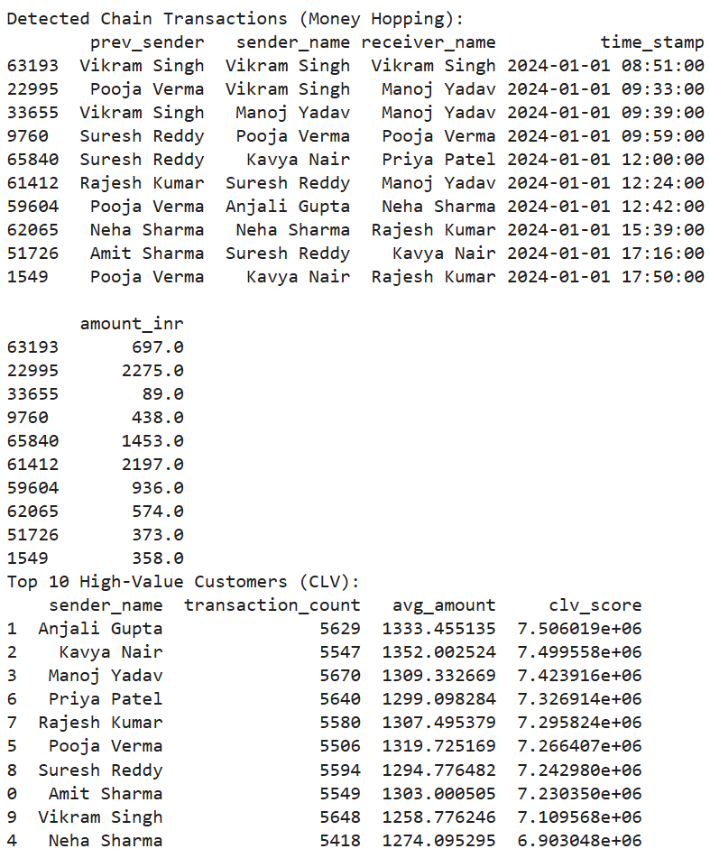
Chain Transactions (Money Hopping Detection)
This finds quick transfers between connected accounts within minutes. It helps uncover money-laundering or linked fraud activities.

Slide 24
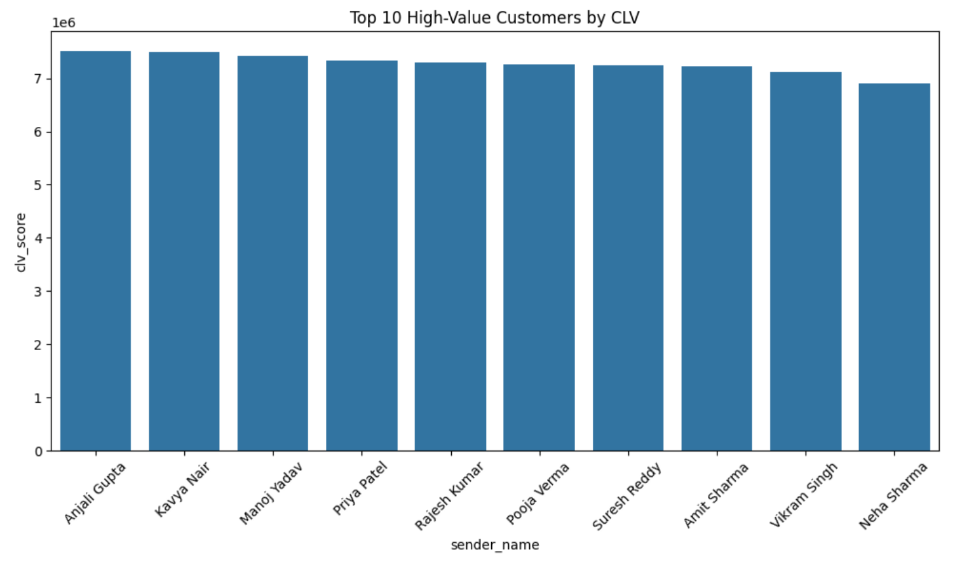
Top 10 High-Value Customers (Customer Lifetime Value – CLV)
This identifies users with frequent and high-value UPI transactions. It helps banks monitor important customers for better fraud protection.

Slide 25
PREDICTIVE MODEL

Slide 26
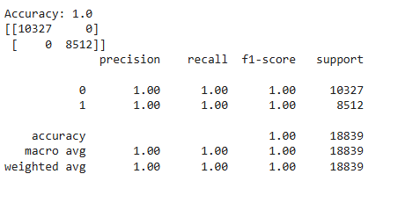
Predictive Model (Random Forest Classifier)
The Random Forest Classifier is used to predict whether a transaction is fraudulent or genuine. It uses the fraud flag created earlier as the target variable for training and testing the model. Multiple decision trees are combined to improve prediction accuracy and handle complex data. Model performance is measured using accuracy, precision, recall, F1-score, and a confusion matrix.

Slide 27
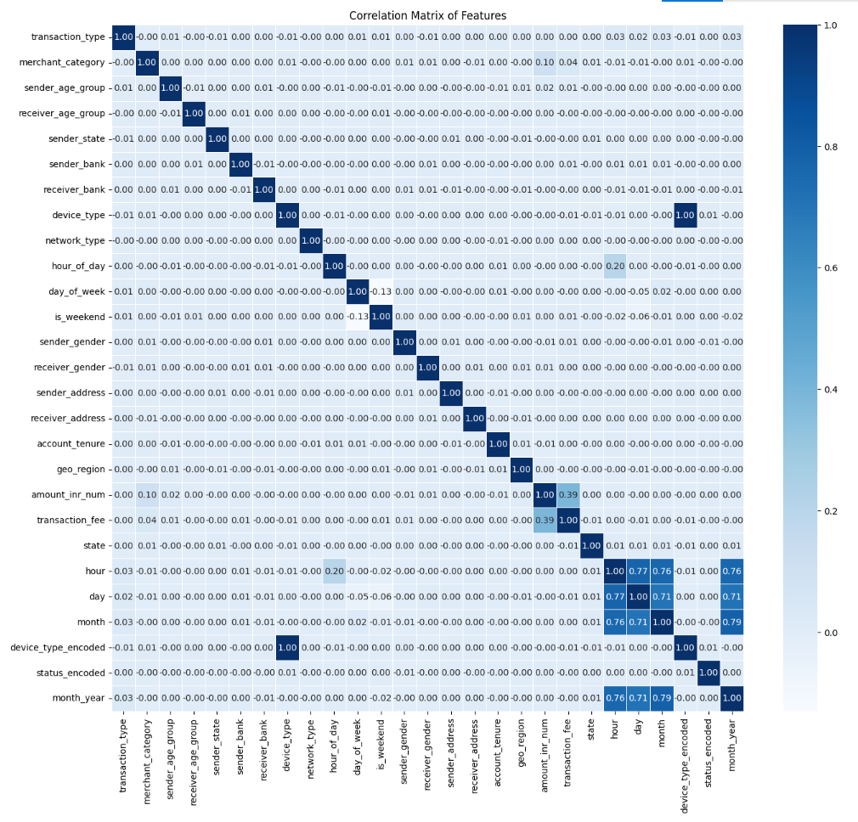
CORRELATION MATRIX
The correlation matrix shows how different features in the dataset are related to each other. It helps identify which factors have the strongest link to fraud and improves model accuracy
Values:
+1 → Strong positive correlation (both values increase together).
-1 → Strong negative correlation (one increases while the other decreases).
0 → No correlation (no relationship between the features).

Slide 28
Conclusion
The project effectively detects fraudulent UPI transactions using data science and machine learning techniques. By applying data cleaning, preprocessing, and visualization, key fraud patterns were identified from transaction data. The Random Forest Classifier, trained using the fraud flag, provided accurate predictions for fraudulent cases. This system enhances the safety of digital payments, helps banks detect fraud early, and builds user trust in UPI transactions.

Slide 29
Thank YOU!

